Slide 1
Version Control with GitHub
SURP 2023 Python Bootcamp
Ohio State Astronomy
Slides by: James W. Johnson

Slide 2

What is GitHub?
A website for hosting files in the cloud
More fundamentally: version control
Tracks changes to your files over time
Can host multiple versions of the same file(s) under the same name(s)
Free to use, with some features enabled with a premium account
Notes:
GitHub differentiates from other file storage services like Google Drive in that it is a tool for version control, which has a specific meaning that will hopefully be clear by the end of these slides.
Premium accounts are something like $8 per month, though researchers can accomplish more or less everything they’ll need with a free account.

Slide 3
What can you do with GitHub?
For researchers:
Share files with collaborators
Manage copies between multiple computers
Backup copy of your work
For software developers:
Track changes to code over time
Collaborate with other developers seamlessly
Notes:
These two categories are definitely not mutually exclusive. For software developers, note orally that the second bullet point about collaborating with others is also true of data scientists as a segway into the next slide.

Slide 4
Why learn it now?
A majority of astronomers and physicists eventually leave academia for data science or other private sector jobs
In these positions, knowledge of version control tools like GitHub is expected.
Notes:
If you apply for industry jobs, you’re really not setting yourself apart by demonstrating knowledge of version control tools like GitHub. It’s more that you’re meeting a minimum expectation, so learn it early and get your practice in. Even within academia, GitHub is a fantastic way to manage your workflow and will make you more efficient in the long run.
If you haven’t used GitHub before, you’ll need to set up an account. This proceeds the same as it does for any other website, e.g., Facebook, Twitter, Netflix accounts.

Slide 5
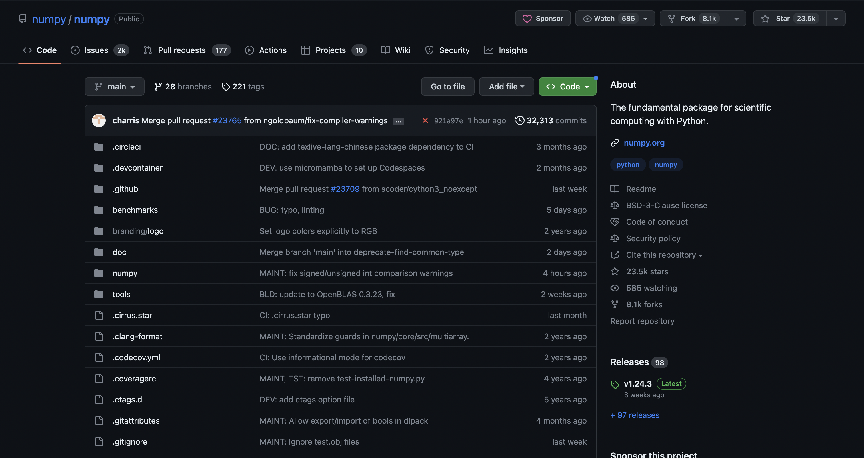
Repositories
A directory containing files and other directories that is stored on GitHub
Example: NumPy, SciPy, and matplotlib each host their source code on GitHub
Files can be anything
Code (including jupyter notebooks)
Documents
Images
Notes:
This slide can be transitioned into by stating that understanding what a repository is is the first objective to learning how to use GitHub. Example repository shown in NumPy’s. The code that you put in your repository can be in any language, and it can serve any purpose – it can just be a few scripts that you wrote, or it can be as large as a production-level python package.

Slide 6
Repositories: Local vs. Remote
Local: this file system on your computer
Remote: this file system on GitHub’s website
Remote will always have the url format github.com/<user>/<repo>
Notes:
Local versus remote really just differentiates between your copy and GitHub’s copy -- this slide simply introduces the terminology for the students. Note that “repo” shown in the third point is a colloquial term that people use, short for repository.

Slide 7
Objectives
Commits: how to make changes to a remote repository
git: terminal application for interacting with a repository on GitHub
Branching: how to store the same file(s) in different states
GitHub websites
Setting up a repository: GitHub itself walks you through this
Notes:
We wait until the end to show them how to set up a repository, because it’s good practice to take a step back and help them understand the ins and outs of git and what’s happening behind the scenes before they try to do any of this themselves. It’s also easy anyway since GitHub’s website will walk you through it.
From an instructor’s perspective, we also do it for the same reason we suggest people not follow along and write the example codes out for themselves during lectures – in practice, helping people get up to speed with GitHub while a new repository is right in front of them rapidly devolves into the instructors fixing everyone’s mistakes as opposed to covering the material that is worth covering. In previous career development workshops, the issue of fixing people’s mistakes has chewed up the entire session.

Slide 8
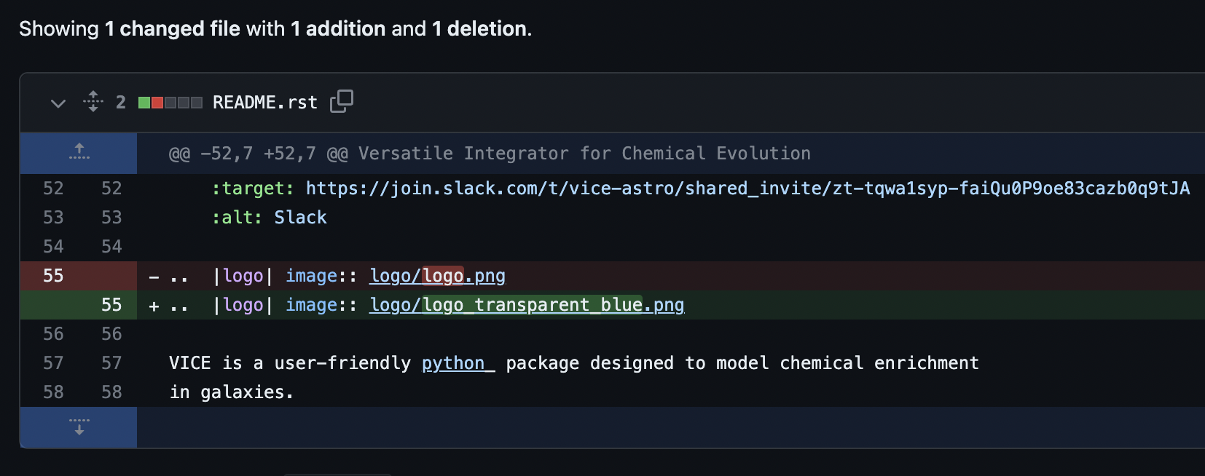
Commits
Bread and butter for making changes to a repository
A series of +’s and –’s within files
Current state of repository = sum of all commits across all files
Tracks bit-by-bit changes to binary files (e.g., PDFs)
Notes:
The example is taken from VICE, where the change is a simple modification of the logo displayed on the README. Even though the lines overlap significantly, GitHub’s algorithm is simple – it’s just a subtraction of the previous line and an addition of the new line.

Slide 9
Commits
That’s about all there is to it!
All of this happens after you’re ready to upload changes to your files
Notes:
At least conceptually, commits in principle are simple – they’re a set of changes that you’re going to upload to the remote copy of the repository. Note that the image says at the top that this commit contains only a 1-line change to a single file, but a commit can contain as many changes as necessary to as many files as necessary. Especially when collaborating on code, it is considered good practice to make frequent commits, each of which contains changes that can be described in a short, declarative statement -- similar to the “no ifs, ands, or buts” concept that is covered in the previous slides on good coding practices.
The second point here can be used to state that when working on your code, you do so completely independently of GitHub – you’re using jupyter notebooks, text files, etc., whatever you’ve otherwise been using all along, and you’ve hit a stopping point where you’d like to now upload these changes to the remote copy of the repo.

Slide 10
git: Managing Repositories
Terminal application for managing a repository, including making commits
Generally pre-installed
Uploading: git add, git commit, git push
Downloading: git pull
git --help prints an API reference in the terminal
No connection to GitHub as a website : git is an open-source version control program
Tracks changes in any set of computer files for projects of any size
Other websites built around git: GitLab, Bitbucket
Notes:
In relation to the previous slide, git is the terminal application to use in order to make commits. It was originally developed in 2005 by Linus Torvalds, who also created the Linux Kernel (very famous software engineer; he has ~183k followers on GitHub as of today). It’s goal of efficiently tracking changes across any set of files of any type is certainly ambitious, and it has met that mandate since its inception while also doing so with impressive speed and data integrity.
GitHub is more widely used than GitLab and Bitbucket, at least within astronomy. If a student is already using GitLab or Bitbucket, they’re more than welcome to continue doing so, in keeping with the mantra that they should use the tools they’re most comfortable with. There are many additional commands not listed on the slide, some of which would fall under the categories of uploading and downloading, but these are the ones that are used the most, and the ones that are the most relevant to researchers and folks getting started with GitHub.

Slide 11
git mv and git rm
Both fulfill the same functionality as mv and rm otherwise do
git mv: rename the file
A bare mv without git will make the new version show up as an untracked file
The file takes its commit history with it
If you mess up, mv followed by git mv is fine
git rm: delete the file
Change will be reflected when others run git pull
Notes:
Starting simple! They saw mv and rm in session 1, so this should (hopefully) be familiar to them.

Slide 12
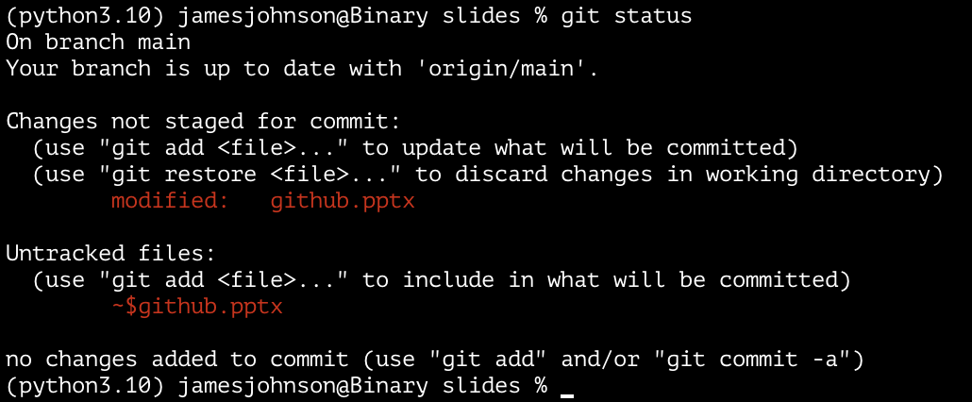
git status: Which files have updates?
Displays the relative paths to files that
are new and not yet stored within the repository (i.e., “untracked” files)
are already stored within the repository, but have local updates not yet added to the next commit
have local updates that have been added to the next commit
Notes:
In the example, I’m working on this set of slides, so there are changes that have not yet been staged for commit. The file is already tracked by git within this repository, but I’ve updated the slides -- in fact, with this exact slide right here. The file named ~$github.pptx is a temporary copy created by Microsoft office to autosave changes in case the program or my computer crashes, so it shows up as untracked.
We’ll talk about what “on branch main” means later

Slide 13
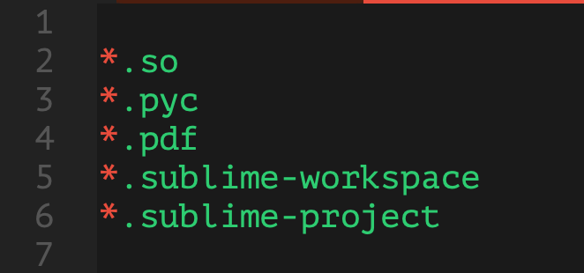
The .gitignore file
git looks for a plain-text file called .gitignore in the top-level directory of all repositories
Contains paths and glob patterns for files that it should skip
Notes:
The example image is the .gitignore file for the repository that hosts all of the source material for this bootcamp – this will tell git to ignore all files that have these extensions. Important to note that files that begin with a ‘.’ are hidden from view by default on Unix systems as it denotes a file that is reserved for the system --

Slide 14
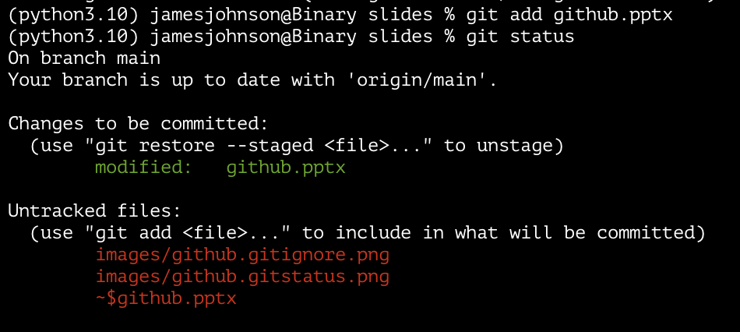
git add and git restore
git add: tells git which file(s) to include in the next commit
Can be as many files as you want/need
Doesn’t have to be every file with changes
git restore [--staged]: the “undo” button
Notes:
In practice, git add is necessary because git does not assume that every file with changes is going to go into the next commit. It lets you specify which ones will go into which commits, so if you’ve got many files with changes, you can upload them to the remote repository with multiple commits if it makes sense to do so.
In the example, I’ve went ahead and ran “git add github.pptx” to tell git to include this powerpoint file in the next commit. Then I run “git status” and now it says that these changes are to be committed. It also shows that there are now some image files that I added to these previous slides – they’re showing up now that I’ve been adding images to the repository to create this set of slides.

Slide 15
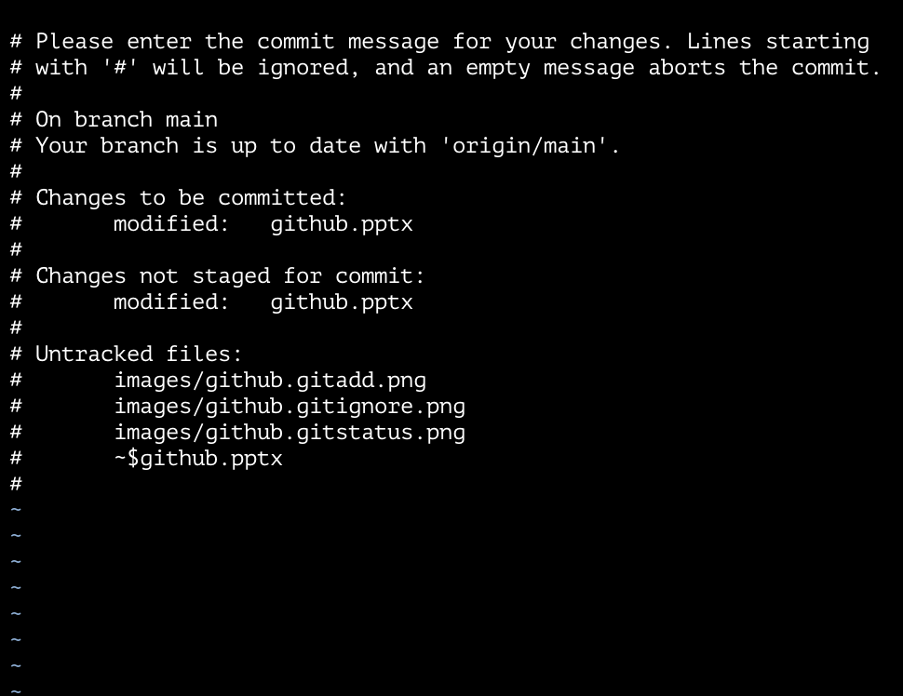
git commit
Creates the commit itself
Command will open the vi text-editor and prompt you for a message to attach to the commit
Press A to enter edit mode
Press Esc to enter command mode, then “:wq” and Enter will save and quit
git commit –m “message here” takes the message in quotes without opening vi
Notes:
In principle, the message should be a descriptive statement about the changes. In practice, some messages are much less informative than others, especially if the repository is one’s own personal code. In these cases, you’ll see messages like “end of day commit” or “progress on <something>”

Slide 16
git push and git pull
git push: uploads the new commit to the remote repository on GitHub
The first time you do this, it will likely prompt you to run with extra flags to tell it the branch you’re pushing to git push --set-upstream origin main
git pull: downloads new commits from the remote repository
Display remote URL: git remote –v
Set remote URL: git remote set-url origin [url]
Notes:
Again, we’ll talk about branching in a few slides

Slide 17



git gud: for when coding is as hard as Dark Souls
Notes:
Joke slide: use this as a point to break for questions about what’s been covered so far
For the uninitiated: the reference is to the game Dark Souls and other titles from FromSoftware, known for their difficulty that cannot be adjusted to accommodate the noobz.

Slide 18
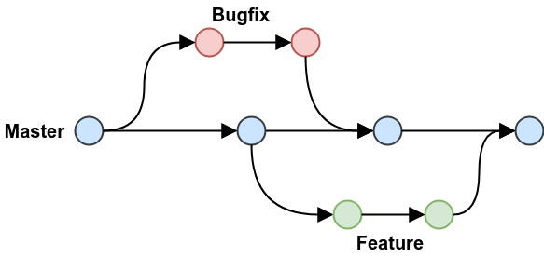
Branches
Different branches track different commit histories
Current state of file(s) = sum of commits on a given branch
Of particular importance if you are developing software that will be distributed/released
Note: default name of the “primary” branch x to be master but is now main
Notes:
The utility of branching lies in the ability to switch between different “states” of the code base, so that in-progress work on one feature doesn’t interfere with the development of another feature. This is more important for software development, but can be useful in research as well.
The bullet point clarifies the point from before that the current state of the file is the sum of all commits on that file to say that only commits on the current branch apply. The second point will be made more clear on the next slide. Good point to state is that nearly all images on google when you search “github branches” use terminology from software development (e.g., feature, development, bug fix).

Slide 19
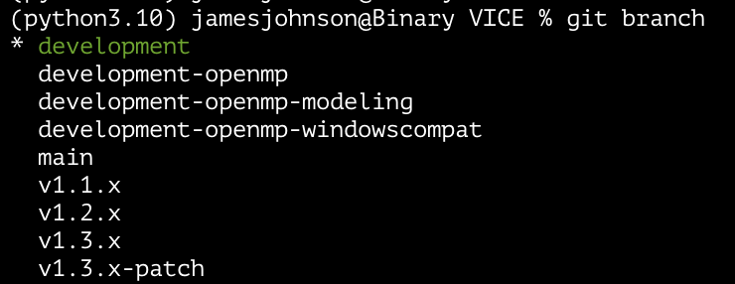
git branch: Displays which branch you’re on
Branching in production-level code:
Development
Different features on their own branches
Recently released versions
Main branch usually latest release
Branching for researchers:
Can be used to store the same files in different states
More useful if your code base gets large
Notes:
In this example, I’m in the root level directory of VICE, the open-source galactic chemical evolution python package that I maintain. There is a base development branch with several branches off of it on which different features are being implemented. There is a main branch, from which releases are packaged and version tagged. There are branches for recently released versions so that the code base can be easily reverted to one of them. There is also a patch branch – the most recent release is 1.3.0, and a patch is in the works, which will soon become version 1.3.1.

Slide 20
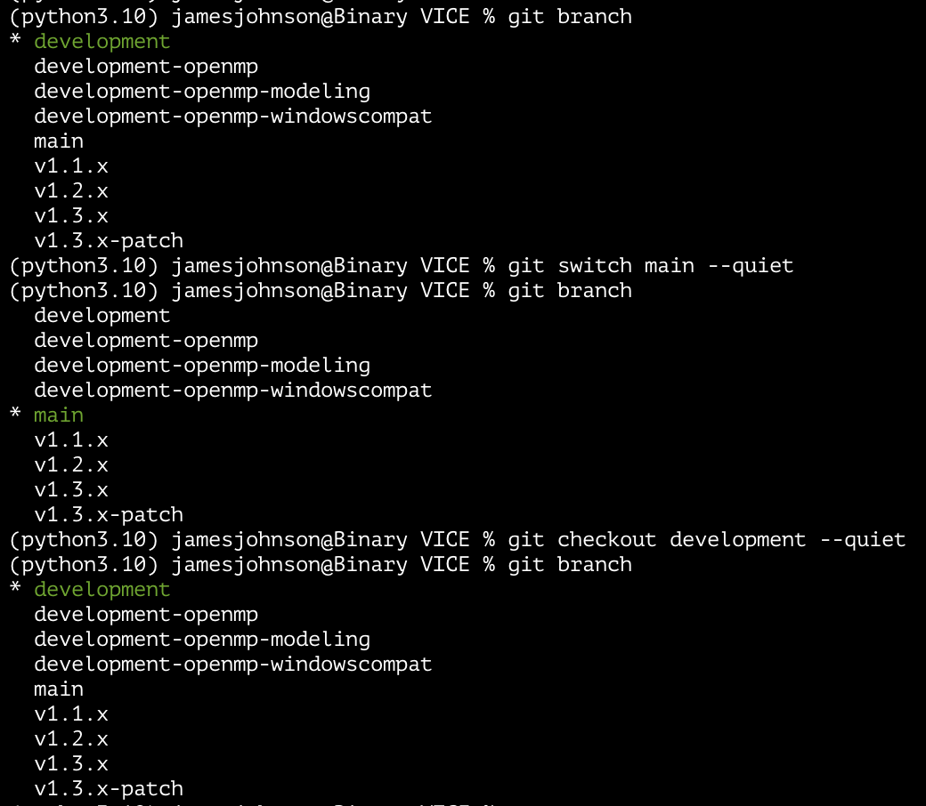
git switch
Changes between branches locally
Can also be done with git checkout
checkout can also be used to copy file(s) from another branch
Will prompt you to commit your changes if it detects updates in tracked files.
Notes:
Generally, you will have to commit changes you’ve made on one branch before switching branches if the changes are in a file that is tracked by git. If it is an untracked file, this usually doesn’t happen.
Note: The “--quiet” flag in the example is simply suppressing print statements that are occur on each switch.

Slide 21
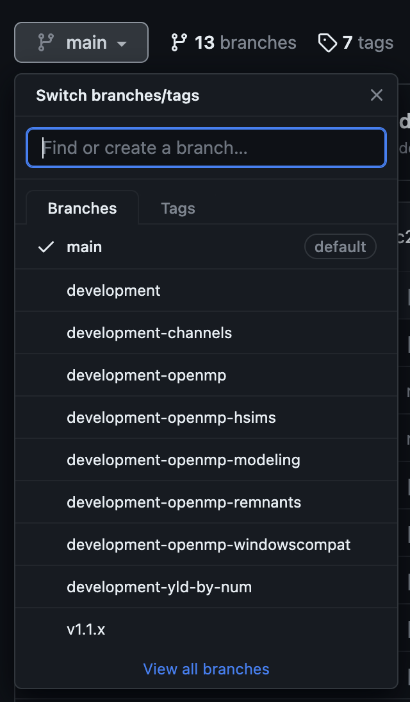
git branch: A new branch
git branch <new_branch> will create a new branch with whatever name you give it
git push --set-upstream origin <new_branch>
You can also create a new branch on GitHub’s webpage for your repository, then
git pull
git switch <branch_name>
git branch --delete <branch_name> will delete the local copy of the branch
Notes:
Regardless of where you’re creating the new branch, you want to be on the branch that you want it to start from. So for example, a branch for developing a new feature would want to start from the development branch as opposed to the main branch.
With --set-upstream, you can simply git pull on the current branch. If you don’t include this flag though, then you’ll have to specify the branch on subsequent commits with git pull origin <new_branch>.
For the second point, simply note orally that the text box at the top says to find or create a branch.
For the third point, deleting the remote copy of the branch requires going to the repository’s webpage on GitHub, viewing the branches themselves by clicking the button next to the drop-down window, and deleting the one(s) you want to delete.

Slide 22
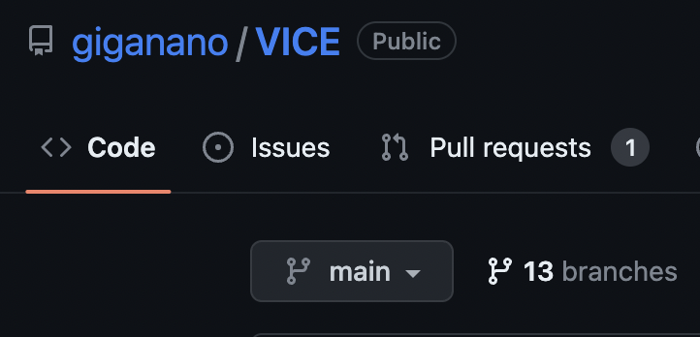
Merging branches
Copies the commits on one branch into another branch
When collaborating, open a pull request. Merge will be handled on GitHub’s website.
Locally, you can use:
git switch <into_branch>
git merge <from_branch>
git push
Notes:
The lines at the bottom will merge the branch from_branch into the branch into_branch. The downside of this is that for collaborative code bases, is that pull requests are usually where code reviews and (for commercially funded projects) project quality assurance (PQA) occurs, and local merges skip this step.
Doing this on GitHub’s website also makes handling merge conflicts much easier. These occur when there are changes to the two branches that you’re merging which are not compatible with one another -- in these cases, git cannot automatically merge the commits and a human has to manually go through and choose which branch’s version to adopt for each individual conflict.

Slide 23
How Researchers Benefit from GitHub
At the end of the day, or whenever you need it: git add + git commit + git push
Later, or simply on a different computer: git pull
No need to handle transfers yourself!
The other system can be a supercomputer (e.g., Ohio Supercomputer Center)
If all you’re looking for is managing files between systems, then add, commit, push, and pull are all you really need
You’re backing up your work in the process
“Can you send me a copy of your code?”
“Sure, here’s a link that won’t change even if the code changes.”
Notes:
Although GitHub is more of an expectation in the private sector, it is definitely not the case that the majority of astronomers use it. However, that does not mean that it is not useful!

Slide 24
GitHub Pages: An easy way to deploy websites
GitHub will host static websites for free!
Static: built using HTML/Markdown as opposed to JavaScript (dynamic)
Popular among academics → more freedom than, e.g., google sites
https://username.github.io → URLs of this format are GitHub websites
Can also be deployed at any URL that you own the rights to
Example: https://giganano.github.io redirects to https://jamesjohnson.space
The source material for this bootcamp is hosted on a GitHub website
https://jamesjohnson.space/bootcamp is really just https://giganano.github.io/bootcamp
Notes:
First and foremost, the goal of this and the next few slides is to show them the things that can be done with GitHub Pages rather than to teach them how to do web development with GitHub Pages. The latter requires some amount of prior knowledge of web development, a topic we could run an entirely different bootcamp on. GitHub does, however, make setting up a website significantly easier by allowing markdown and an ”off-the-shelf” theme as opposed to requiring HTML/CSS/JS.
The example is my own website, which is probably obvious to anyone doing this bootcamp.
Dynamic websites differ from static websites in that static websites, built in HTML, appear the same to all users and only change once the developer/maintainer changes that HTML code. A dynamic website is built live for every visitor, usually JavaScript, and can display different information to different visitors without modification to the source code.

Slide 25
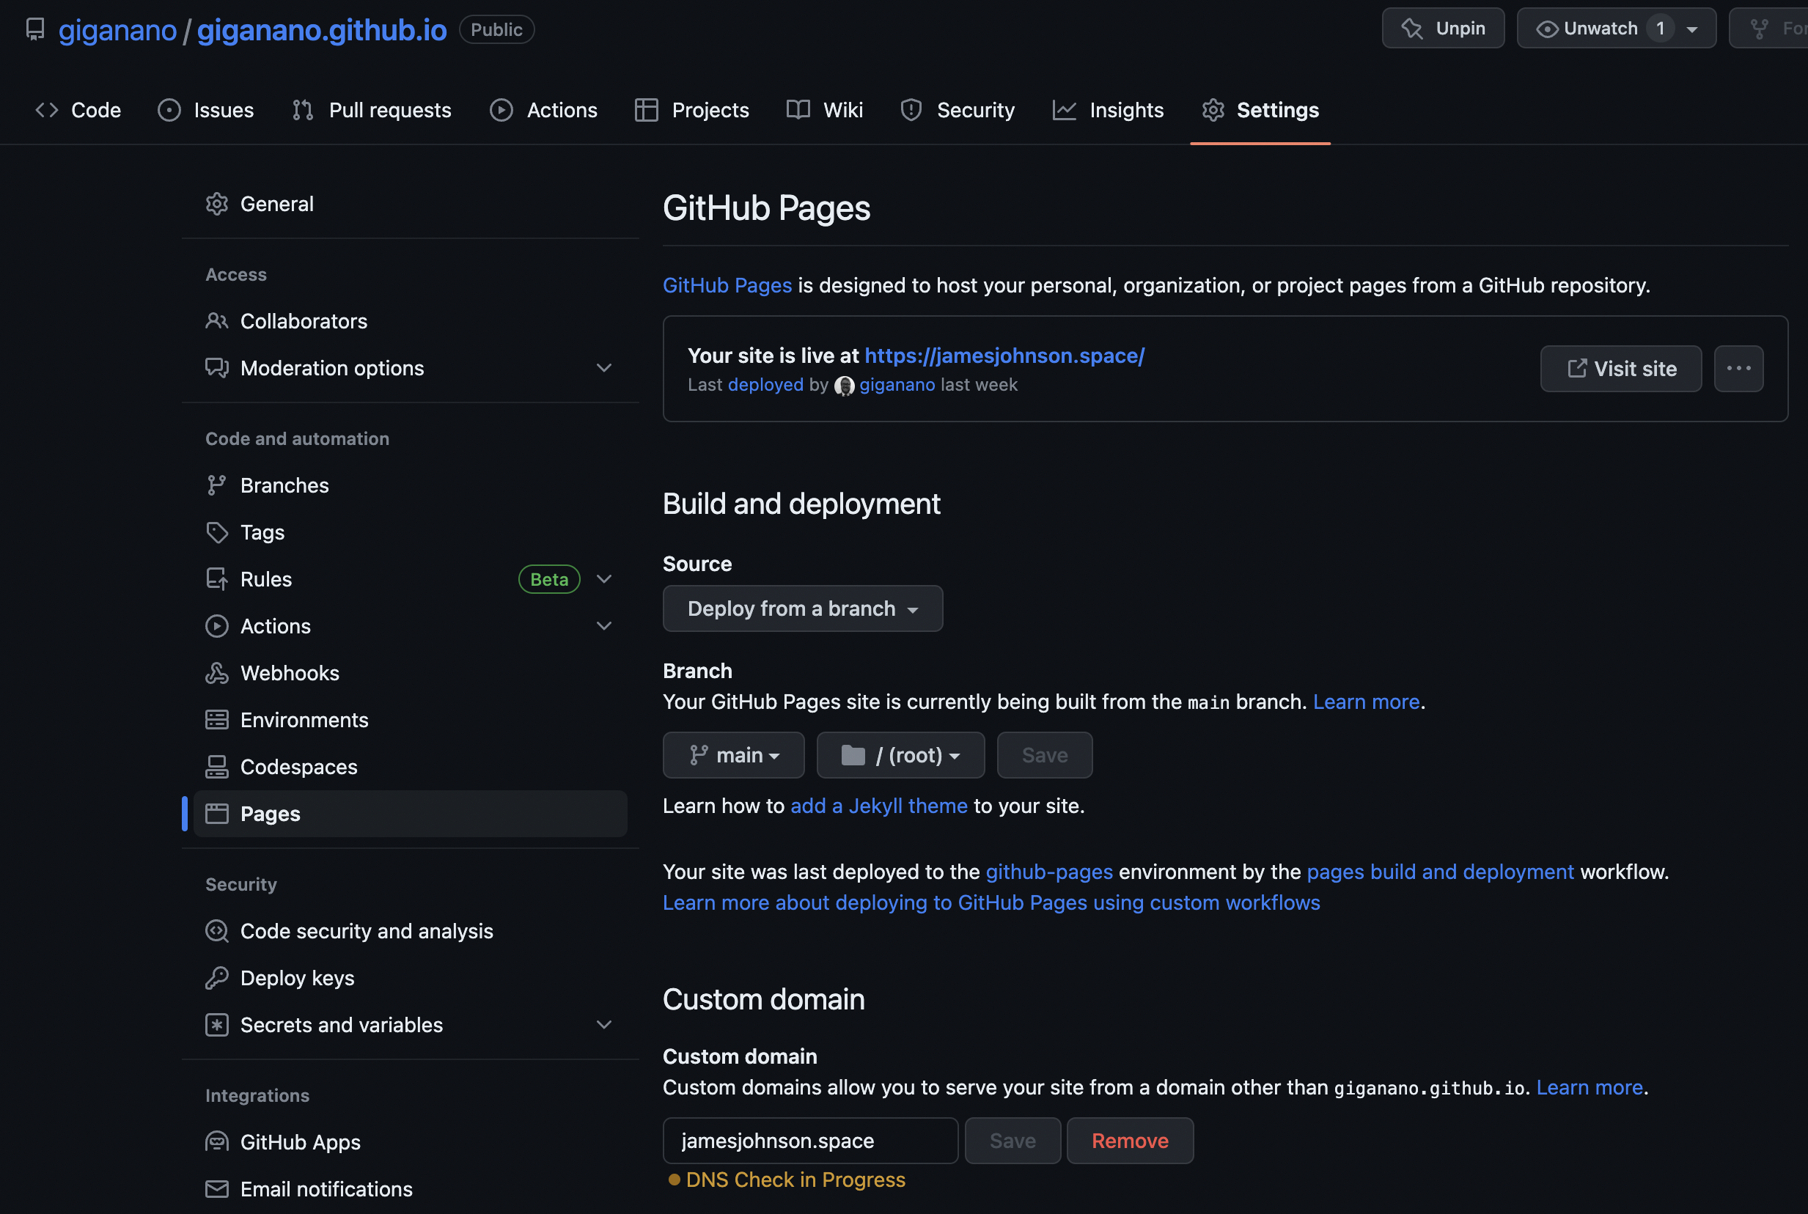
GitHub Pages: An easy way to deploy websites
In repository, navigate to Settings, then Pages, and tell it which branch to deploy from (usually main)
In general, the name of the repo should end with .github.io
Notes:
The simple URL of https://username.github.io requires a repository named username.github.io, and the url of the source code will always be https://github.com/username/username.github.io.

Slide 26
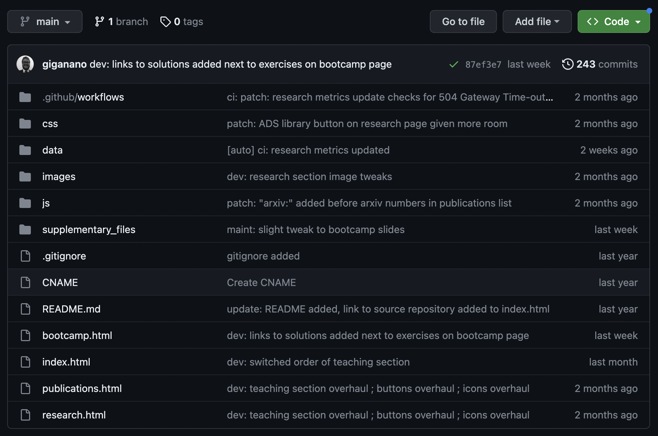
GitHub Pages: An easy way to deploy websites
Built using HTML or Markdown
index.html or index.md will be the website’s front page
Can use your own JavaScript or CSS (Cascading Style Sheets)
Anatomy of a website:
HTML = bones
JavaScript = muscles
CSS = skin
Notes:
The front page of any website will taken from a file named “index” with some extension – “index.js,” for example, for dynamic websites.
HTML, CSS, and JavaScript are the standard languages of web development – we won’t be covering these topics here, but if you’re interested in picking up some of these skills, come chat and we can connect you with resources.

Slide 27
GitHub Pages: An easy way to deploy websites
Built using HTML or Markdown
index.html or index.md will be the website’s front page
You can simply choose an “off-the-shelf” theme to expedite styling
Regardless of HTML/Markdown
Notes:
Another bottom line to emphasize – GitHub has very extensive documentation. References on anything you can do within their website is easily accessible with a simple google search, and there are enough people using GitHub that they are basically always the top result if you simply include “github” in the query.

Slide 28

Creating a repository
Easy if you simply use GitHub’s website
Notes:
This is my GitHub account – simply navigate to your profile, click on repositories at the top of the page, and then there’ll be a big green button in the upper right that says “new.” Click on it.

Slide 29
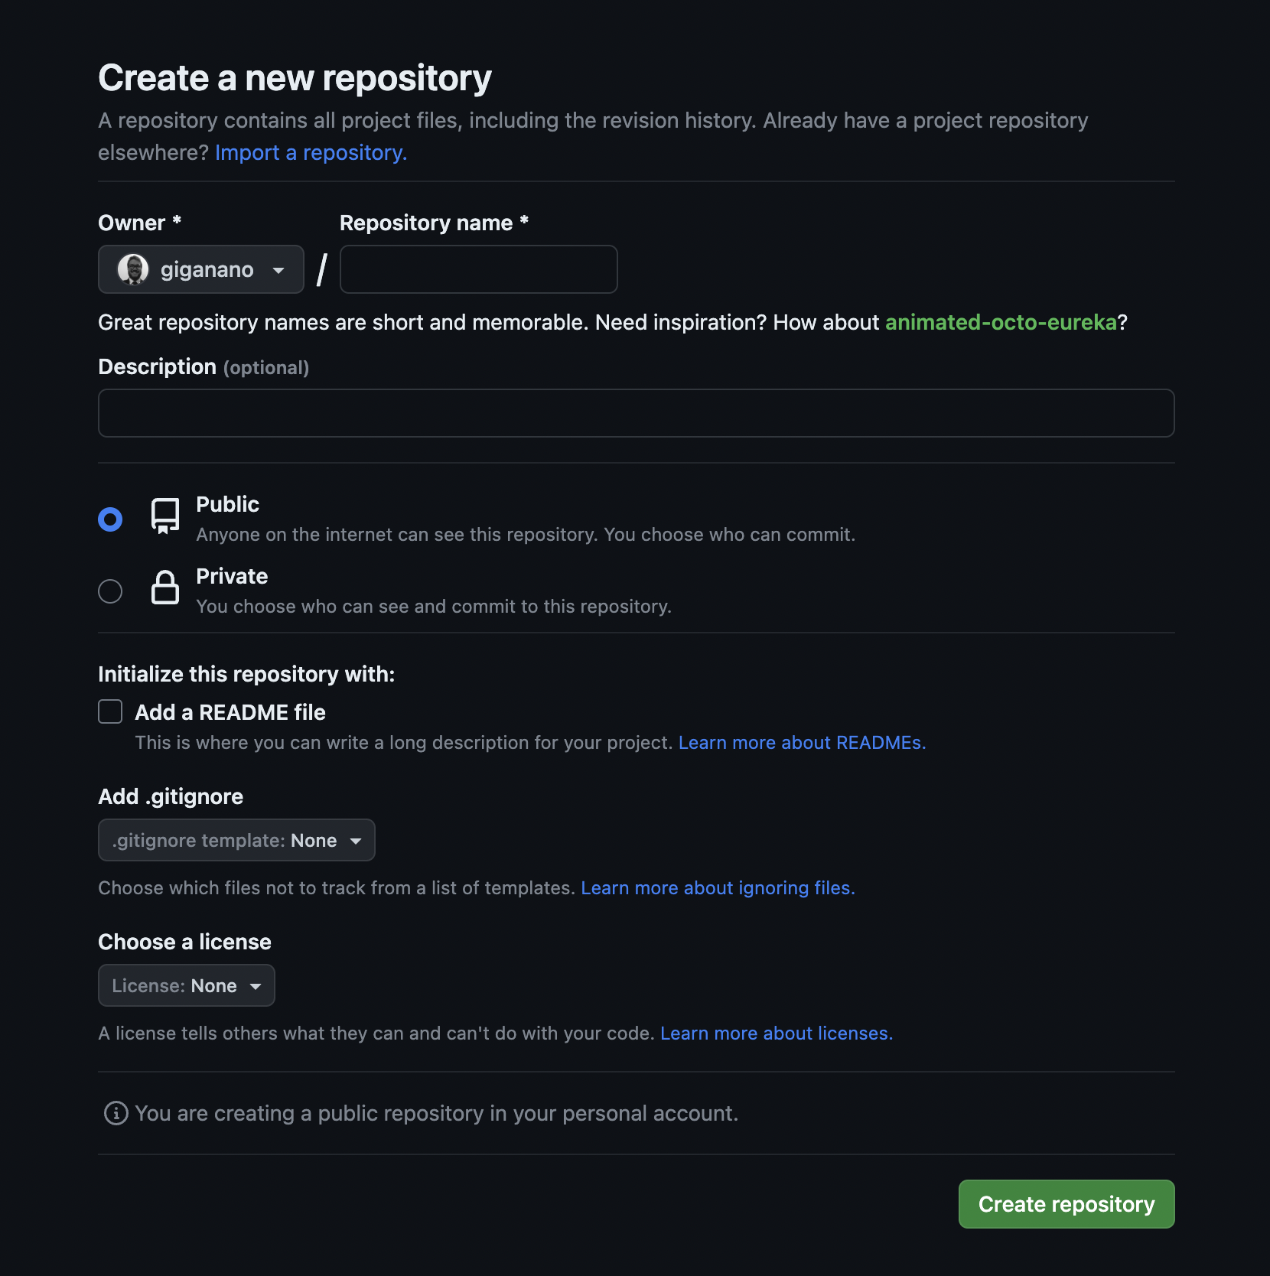
Creating a repository
You’ll land at a page that looks like this
Name it
Private repos require premium
README, .gitignore, and license can be added at any time
Leave them out if this is your first repository
Notes:
This is what you’ll see immediately after clicking on “New” on your repositories page. If this is your first repository, just enter a name and click “create repository.”

Slide 30
Creating a repository
You’ll land at a page that looks like this
Name it
Private repos require premium
README, .gitignore, and license can be added at any time
Leave them out if this is your first repository
The suggested name is usually so random that it’s funny…

Slide 31
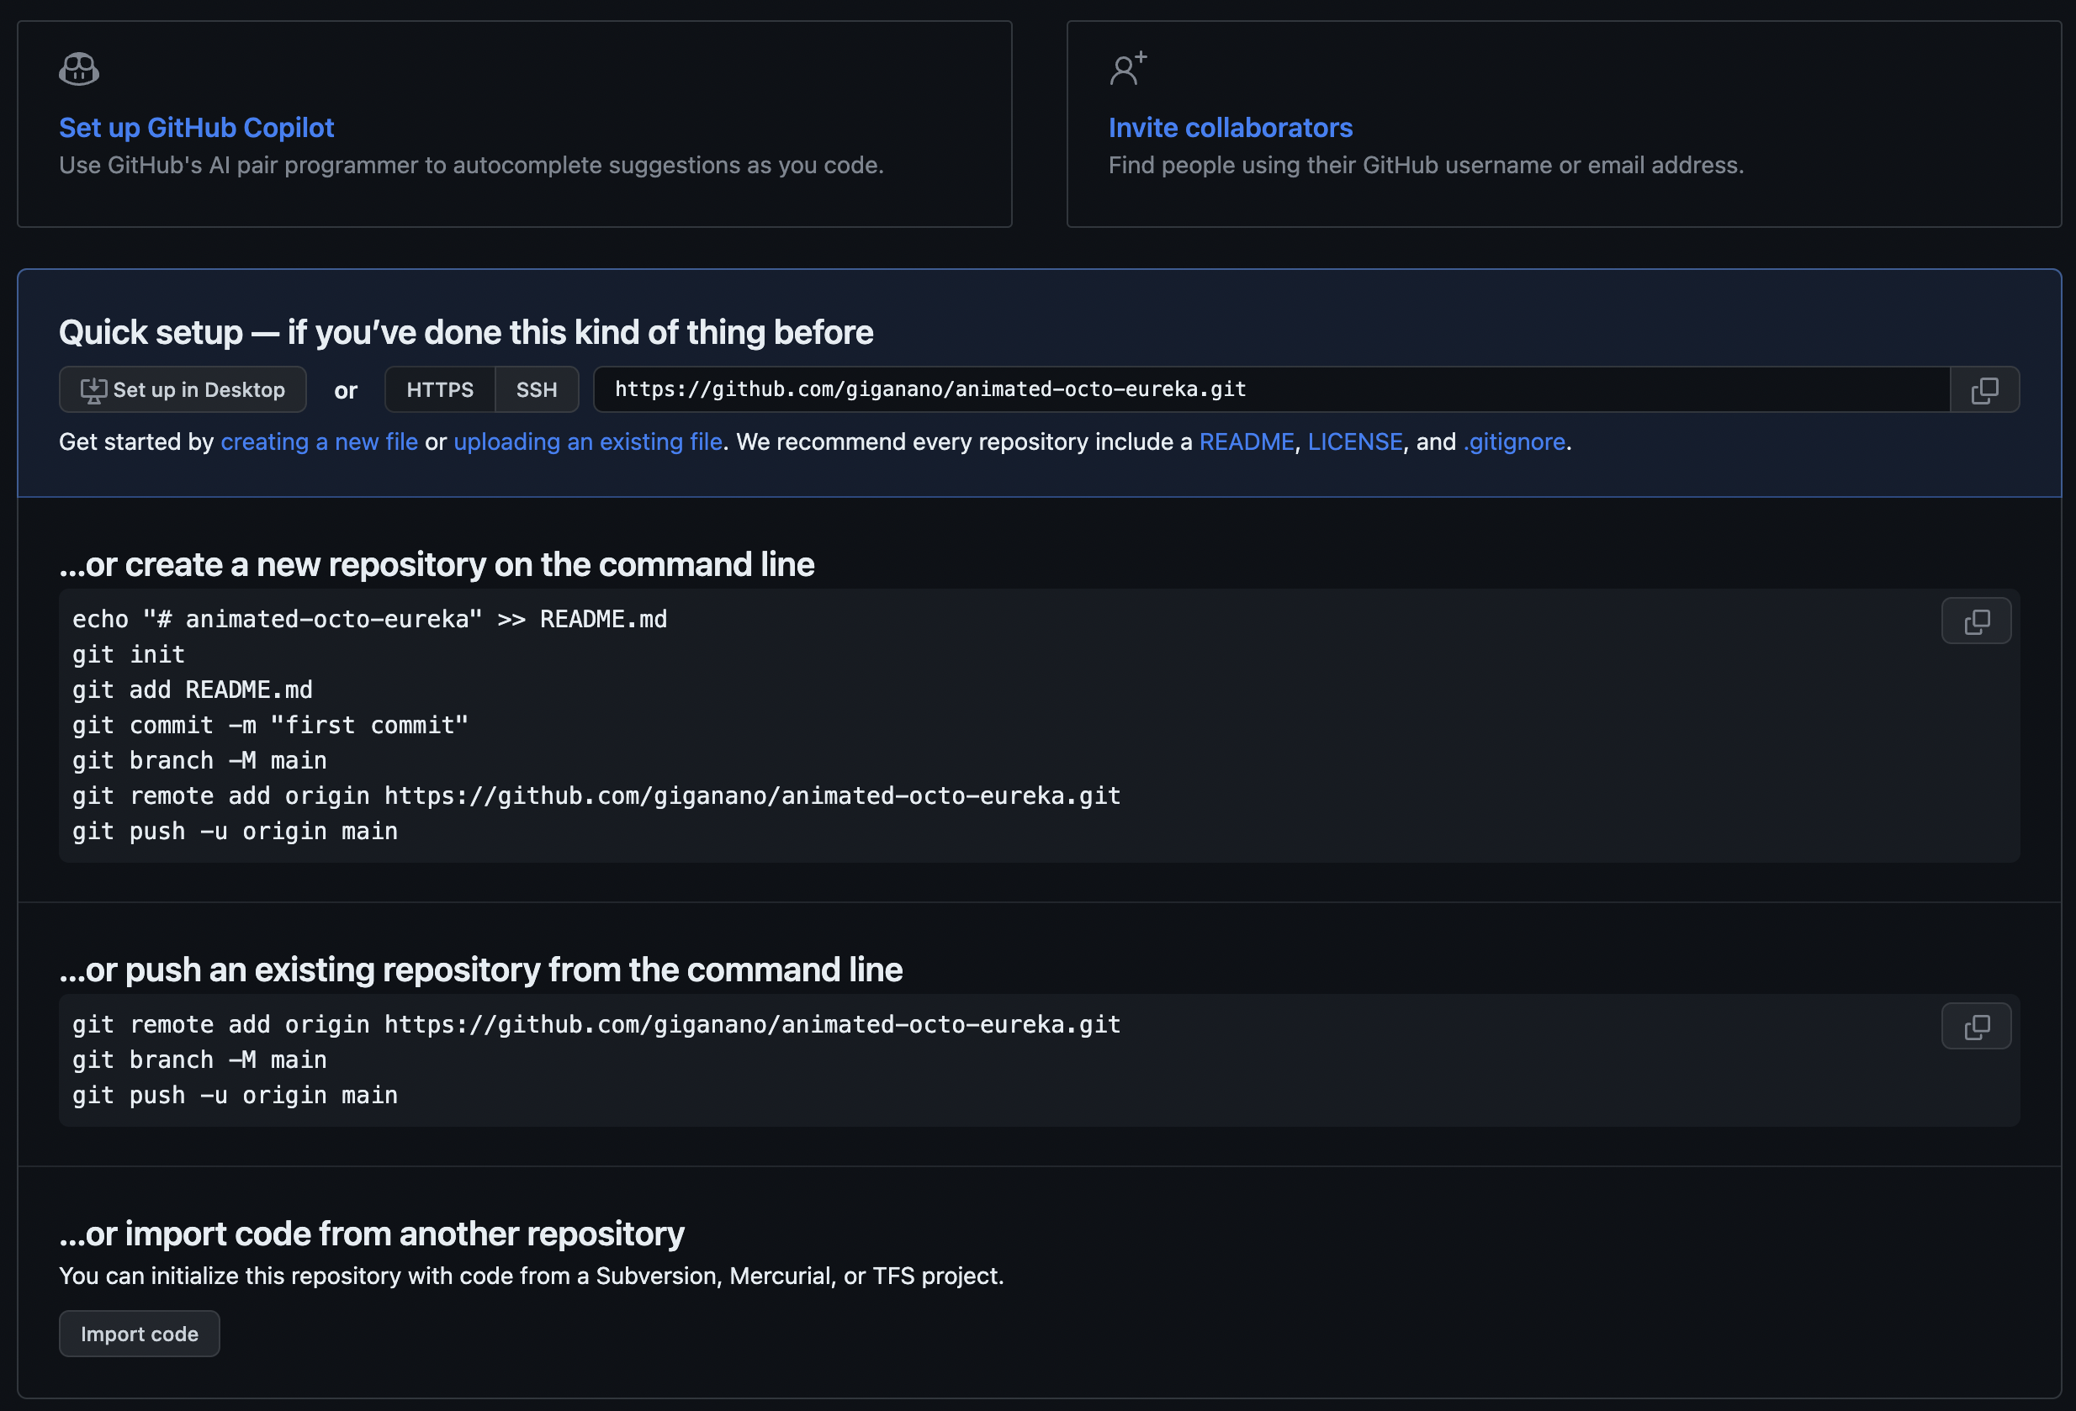
Creating a repository
If you leave out the README, .gitignore, and license, then the landing page of an empty repository will walk you through how to make your first push
From here on, everything proceeds according to the earlier slides
Notes:
I recommend following the steps for creating the repository from the command line – this is the friendliest option for new users.

Slide 32
Thank you!

